Slide 1
Social Media Results
April

Slide 2
KXII’s Facebook has consistently placed between 70-120th place in the company’s leaderboard. After the changes we’ve made this month, our rank grew rapidly. 4/29 we ranked #1 against all Gray Facebooks even ones with millions of followers.

Slide 3
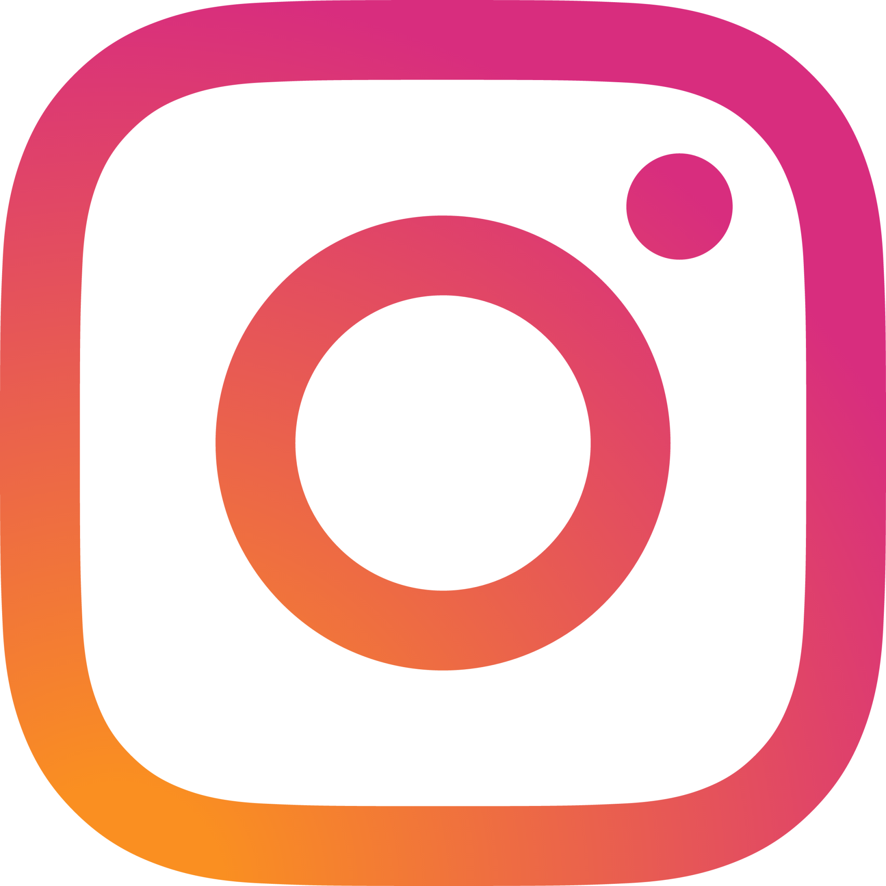
Reach MORE than doubled between March and April on BOTH our Instagram and Facebook Pages.

Slide 4
Instagram Reach increased by OVER 1000% and Interactions increased by OVER 2000%. We gained some followers and every link we posted was clicked (although not many were posted). We also had a differ post

Slide 5
Instagram after 1 month
These dips are weekends.

Slide 6
Facebook Reach and Interactions increased while link clicks went down. We’re assuming this has to do with how much severe weather coverage happened, yet we still ranked #1 after a viral post.

Slide 7
Facebook after 1 month
100,000
These dips are weekends.

Slide 8
We had 2 posts go viral

Slide 9
Youtube views increased by nearly 10,000 in April, with 215 new subscribers

